Slide 1


Slide 2
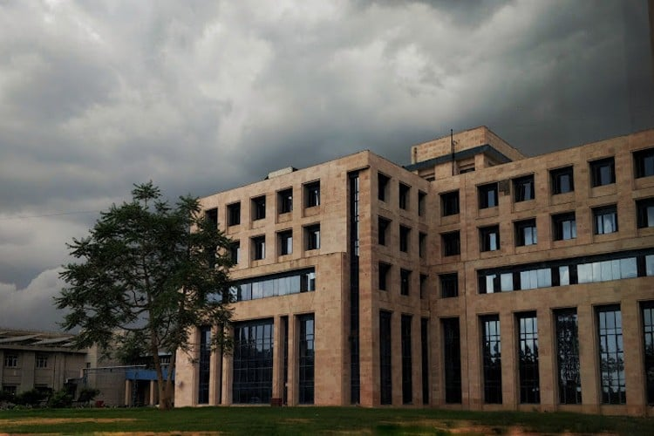

Slide 3
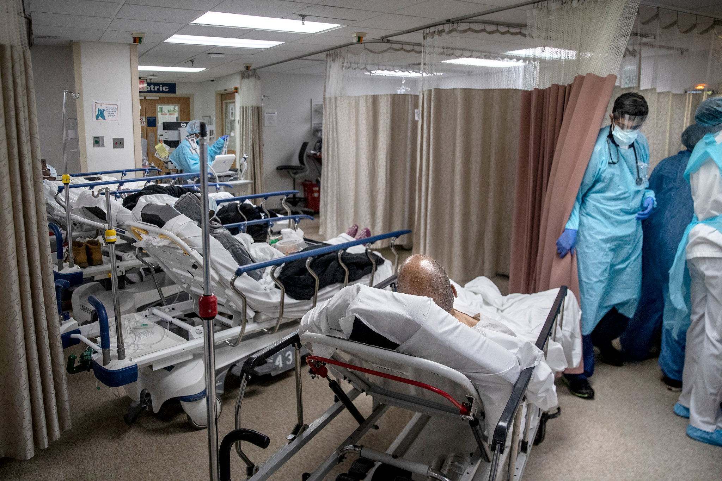
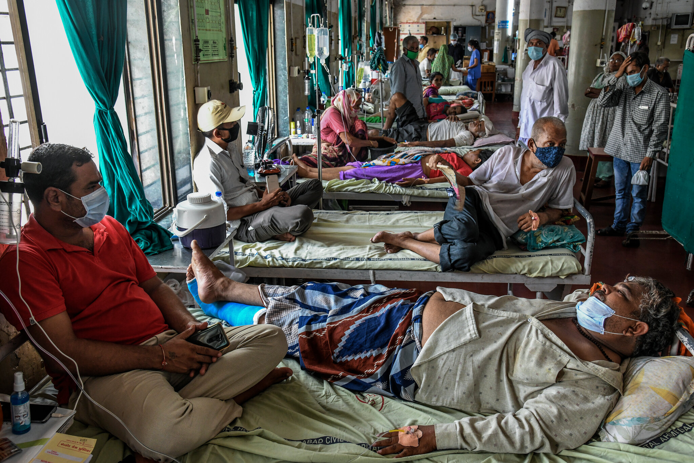
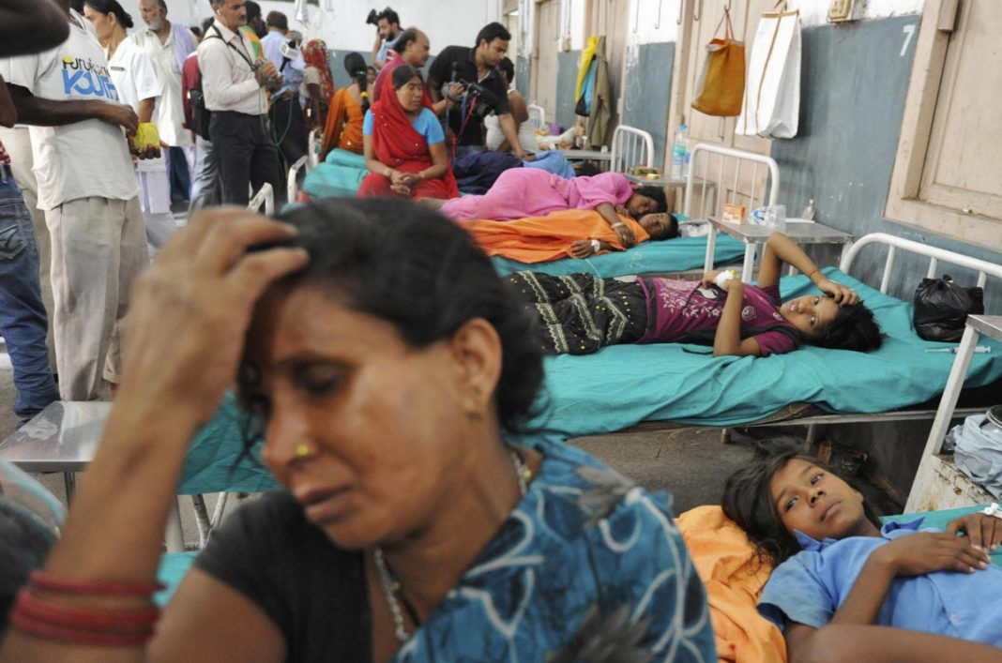
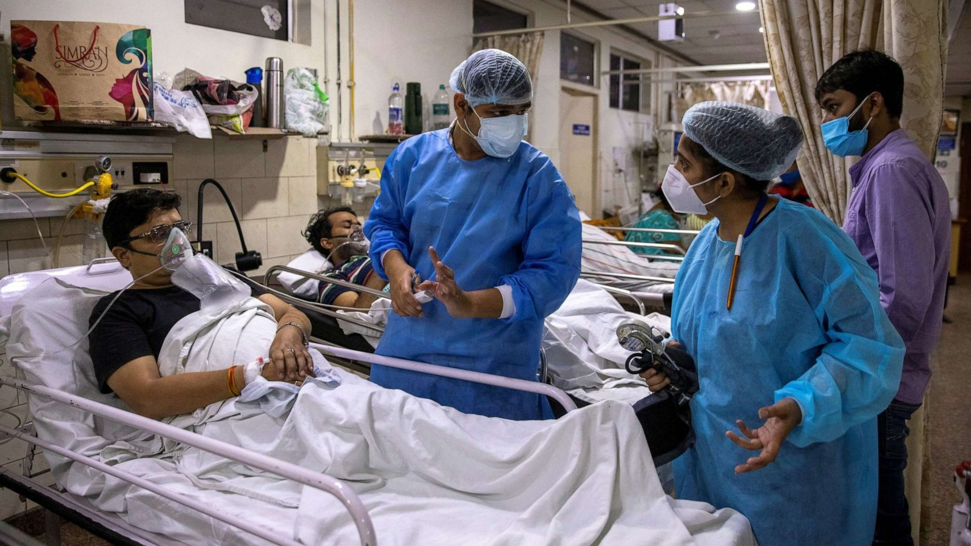

Slide 4

FIGURE, REPORTED CASES AS PER PERCENTAGE

Slide 5

According to World Health Organization estimates, 65 million people have moderate to severe THORAX
More than 3 million people died of COPD in 2005 corresponding to 5% of all deaths globally and it is estimated to be the third leading cause of death by 2030
epidemiologic data on THORAX are difficult and expensive to collect.
However, it is known that low- and middle-income countries already shoulder much of the burden of THORAX with almost 90% of THORAX deaths taking place in these countries
Obstructive lung diseases like asthma and THORAX are the most common respiratory diseases seen in respiratory outpatient services across India
IN INDIA , 60 % health registered is related to THORAX(COPD)

Slide 6
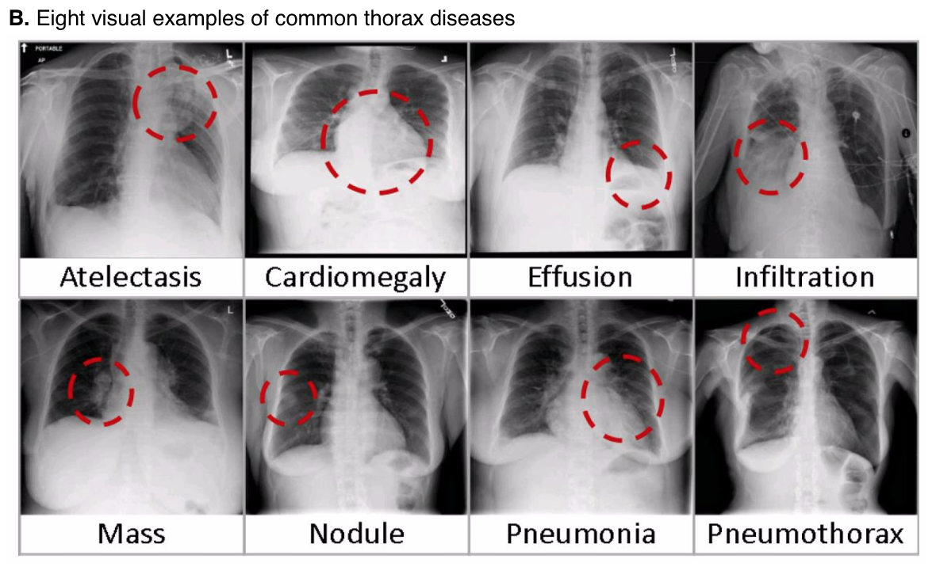

Slide 7
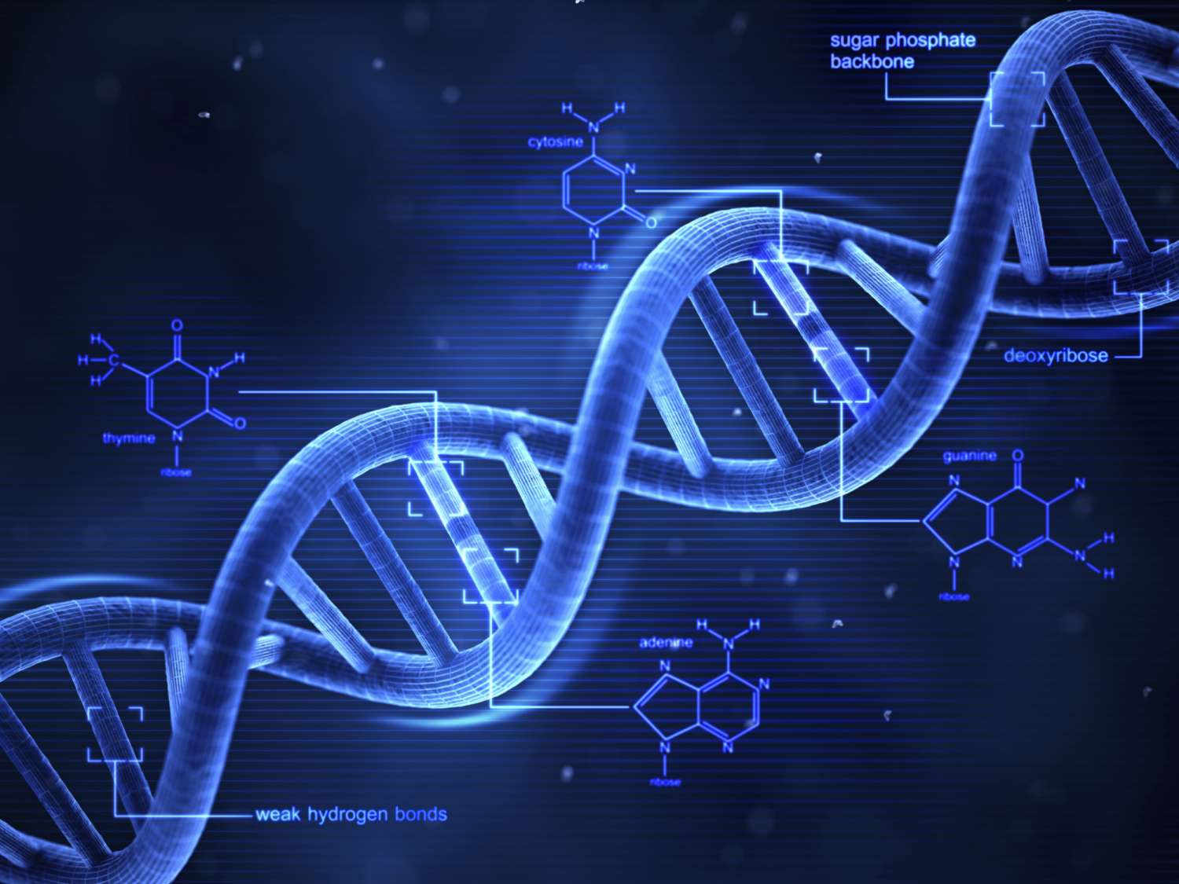





DISCRIMINATIVE FEATURE LEARNING FOR THORAX DISEASE CLASSIFICATION IN CXRI
CXRI- CHEST X-RAY IMAGES
TECHNOLOGY USED

Slide 8
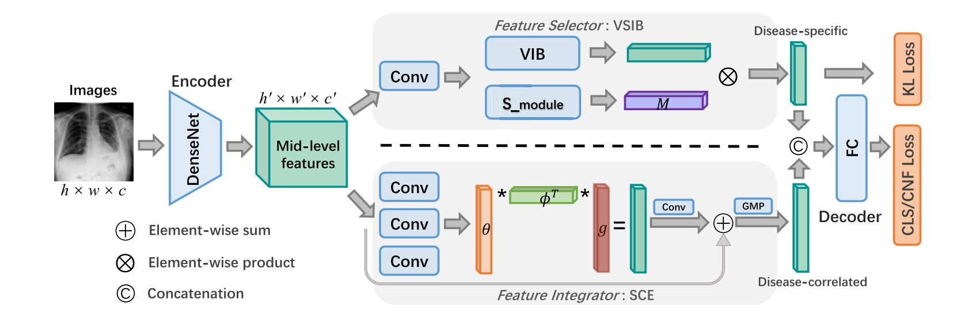
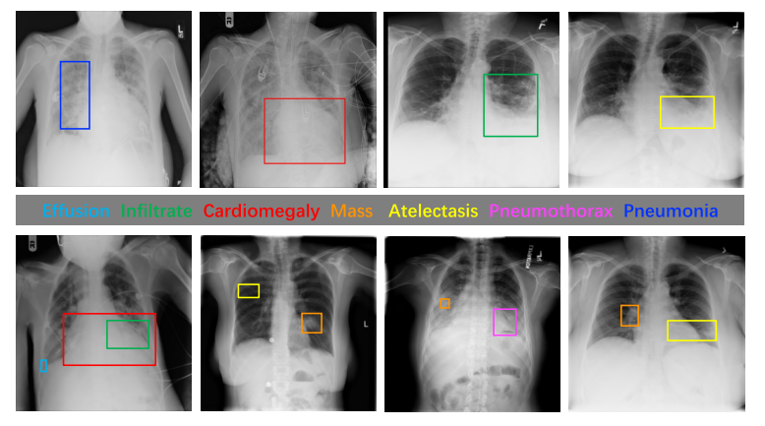
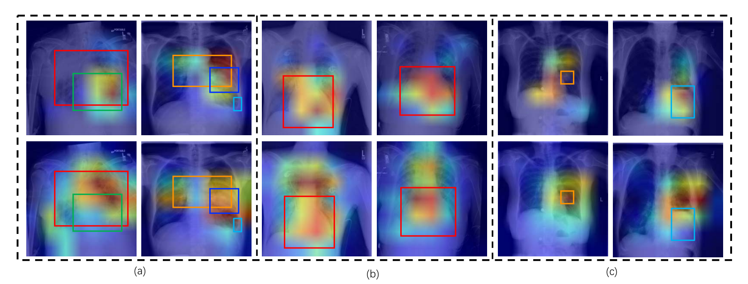

Slide 9
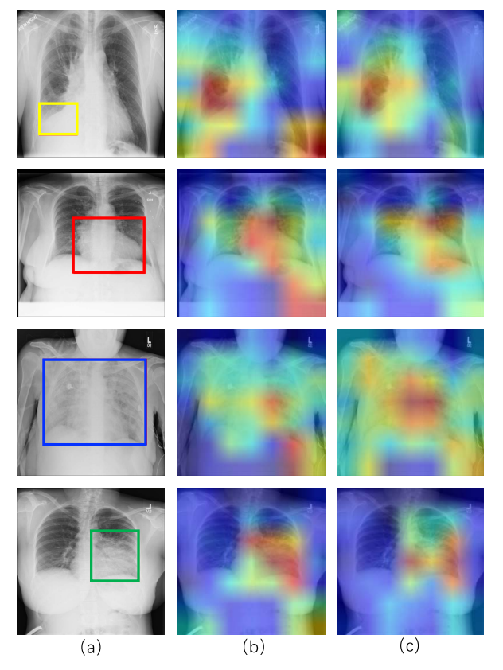
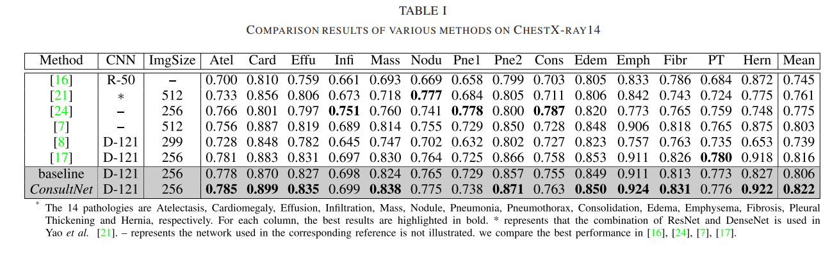
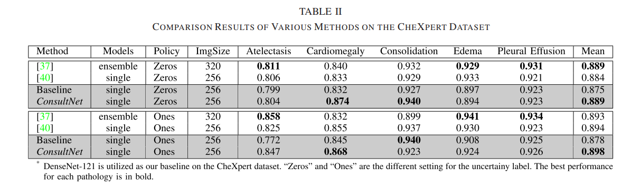
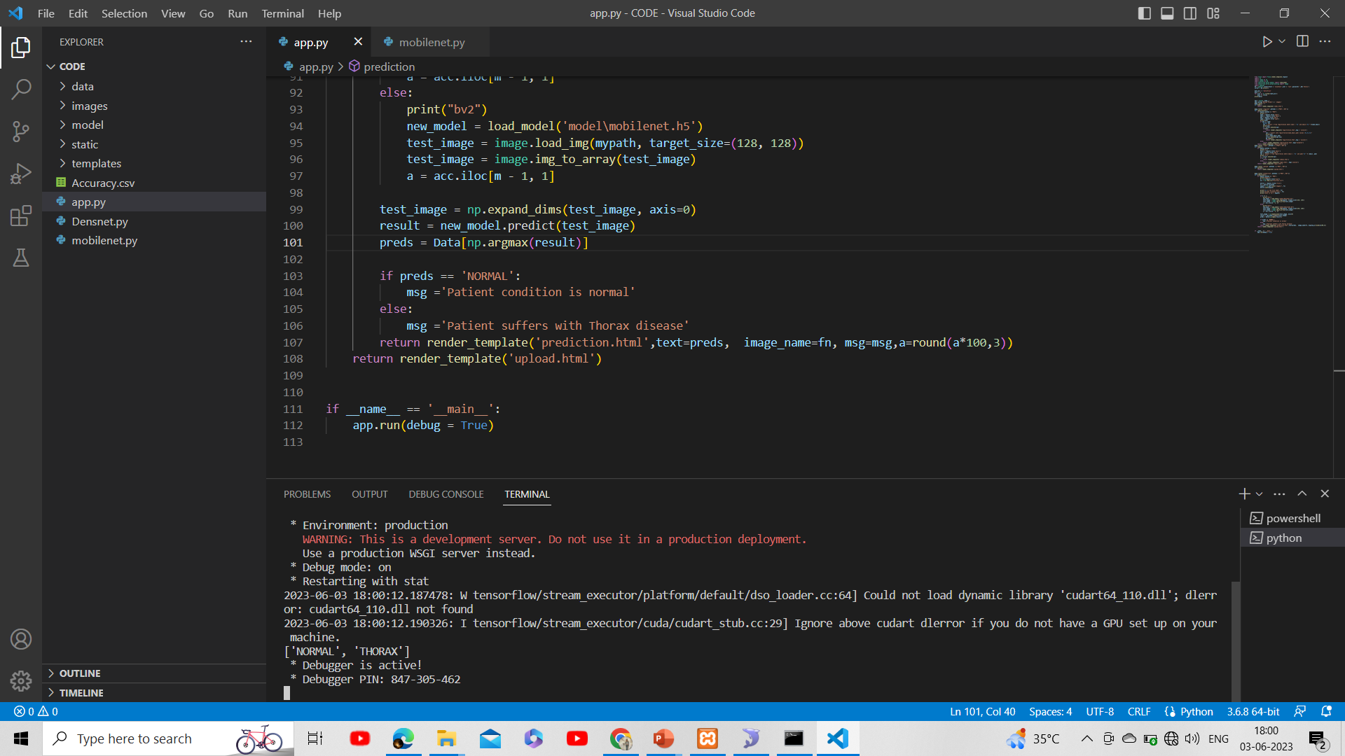
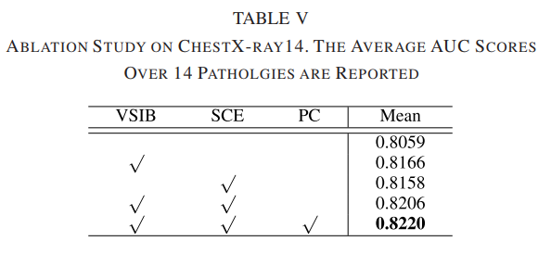

Slide 10


Slide 11
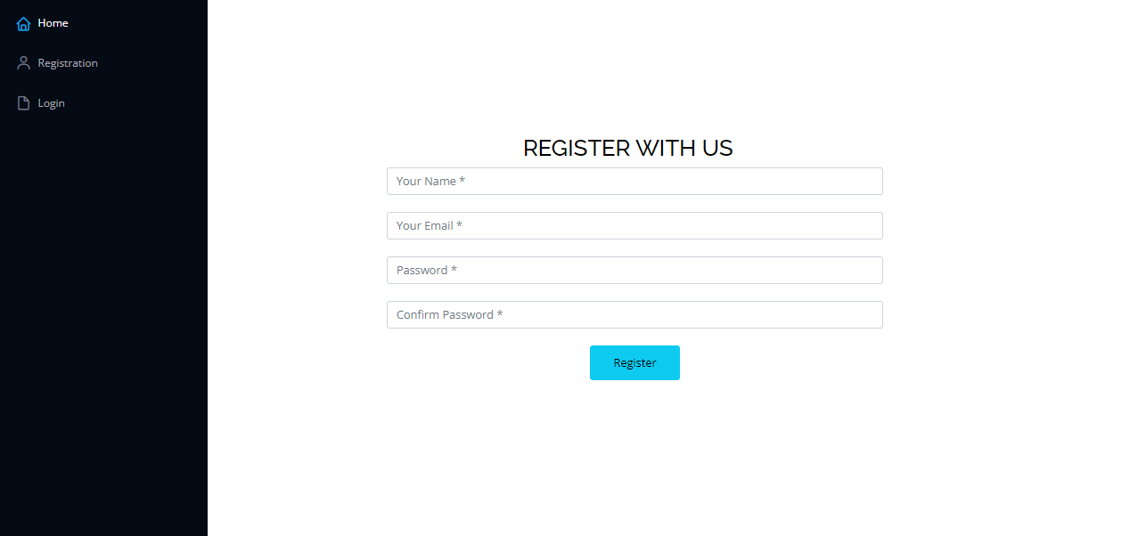

Slide 12
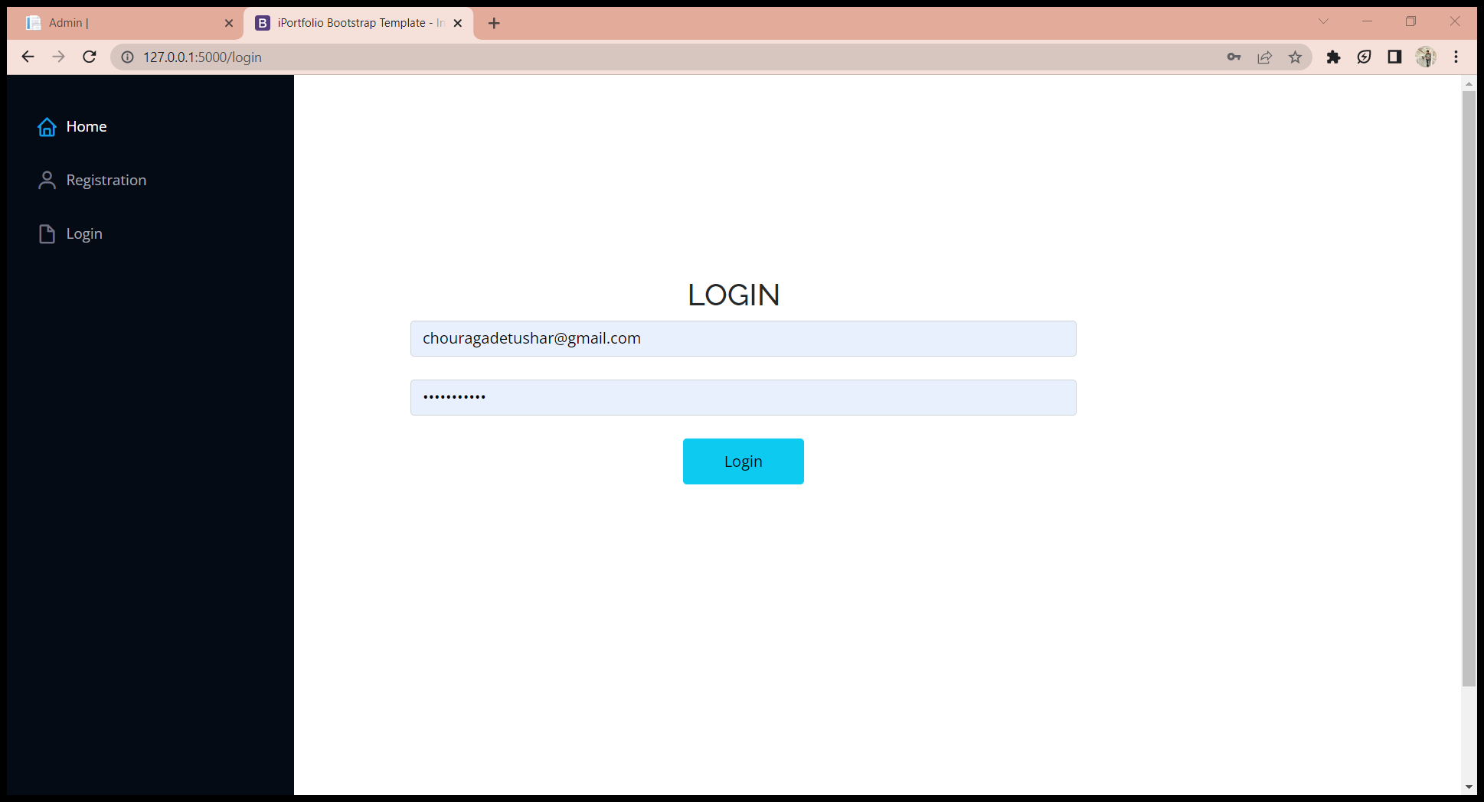

Slide 13
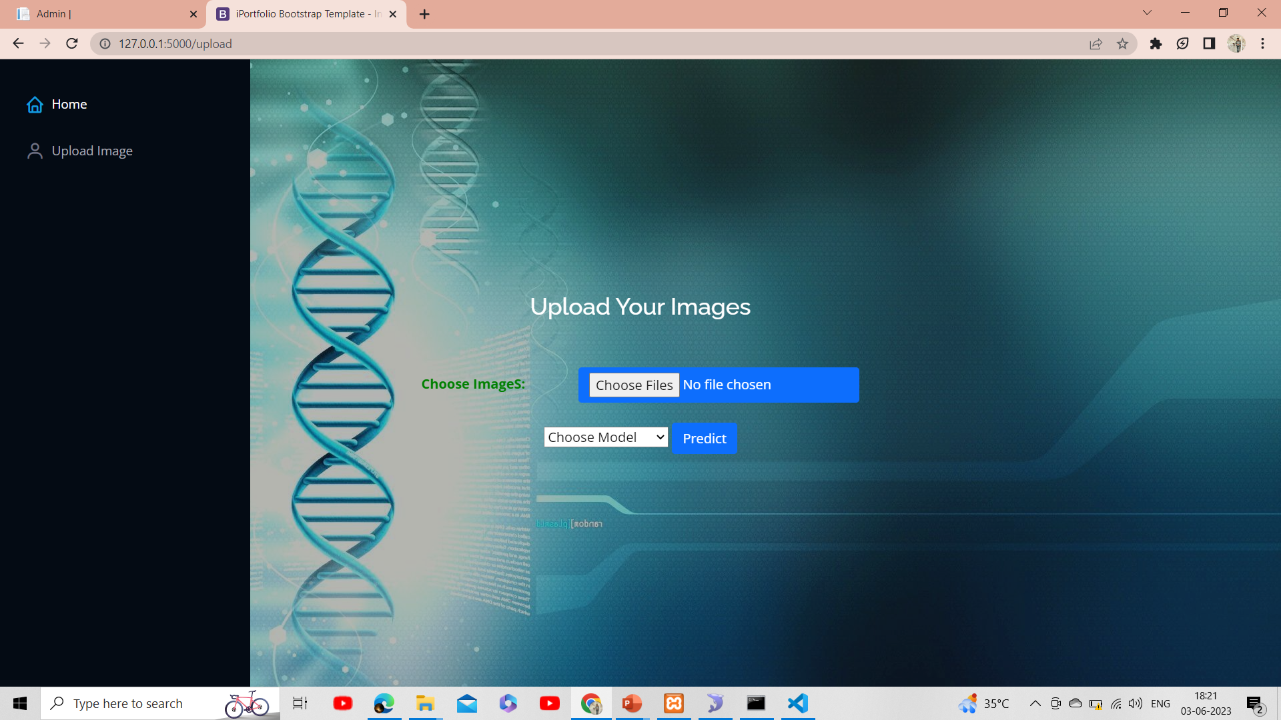

Slide 14
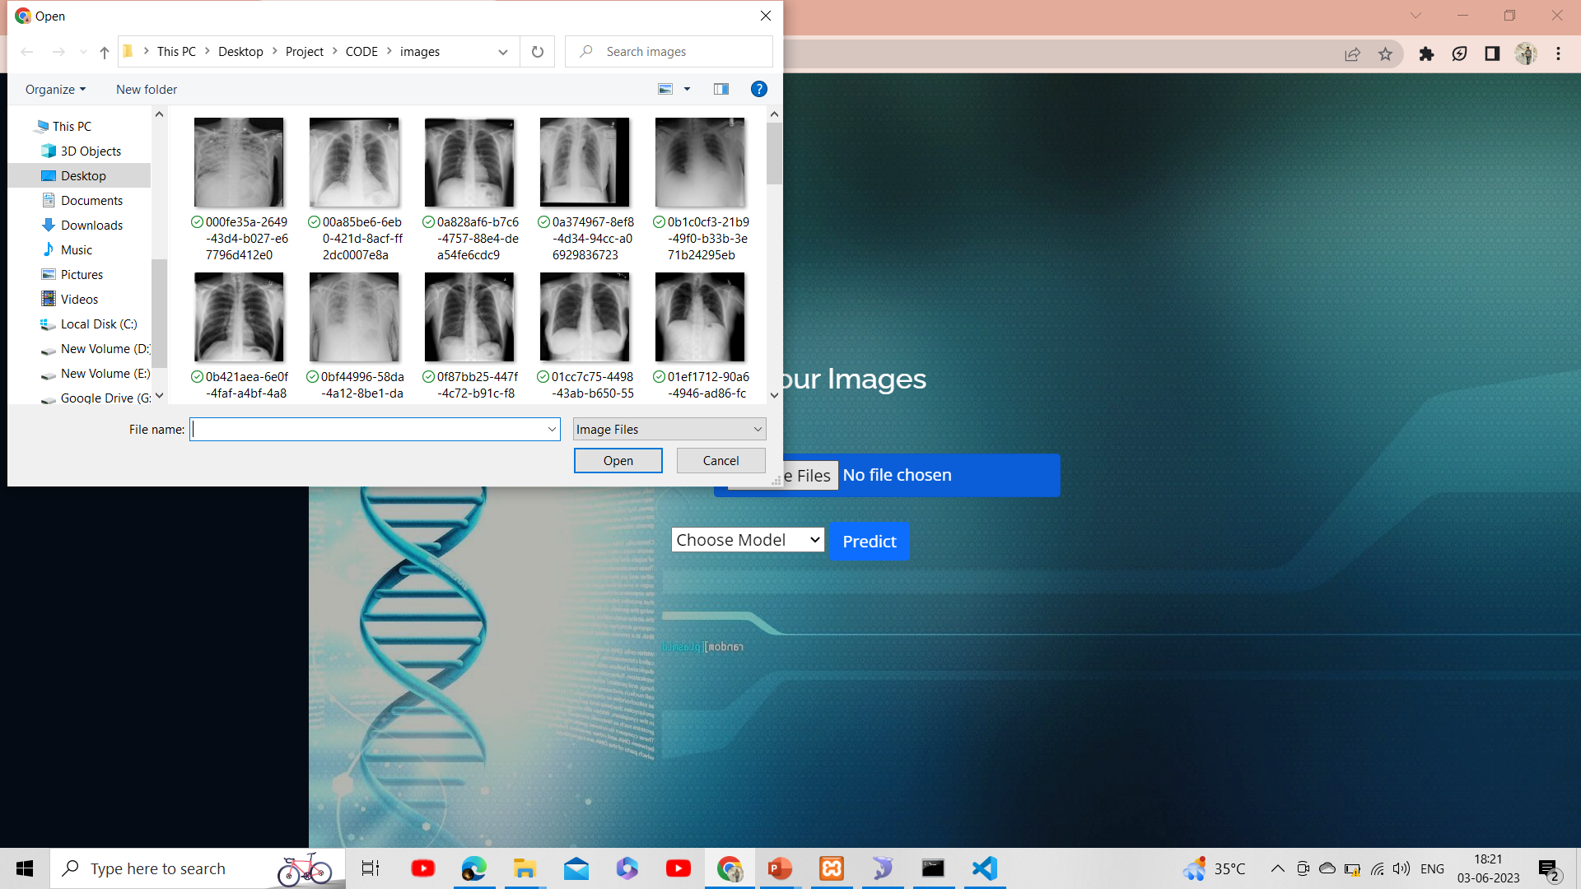

Slide 15
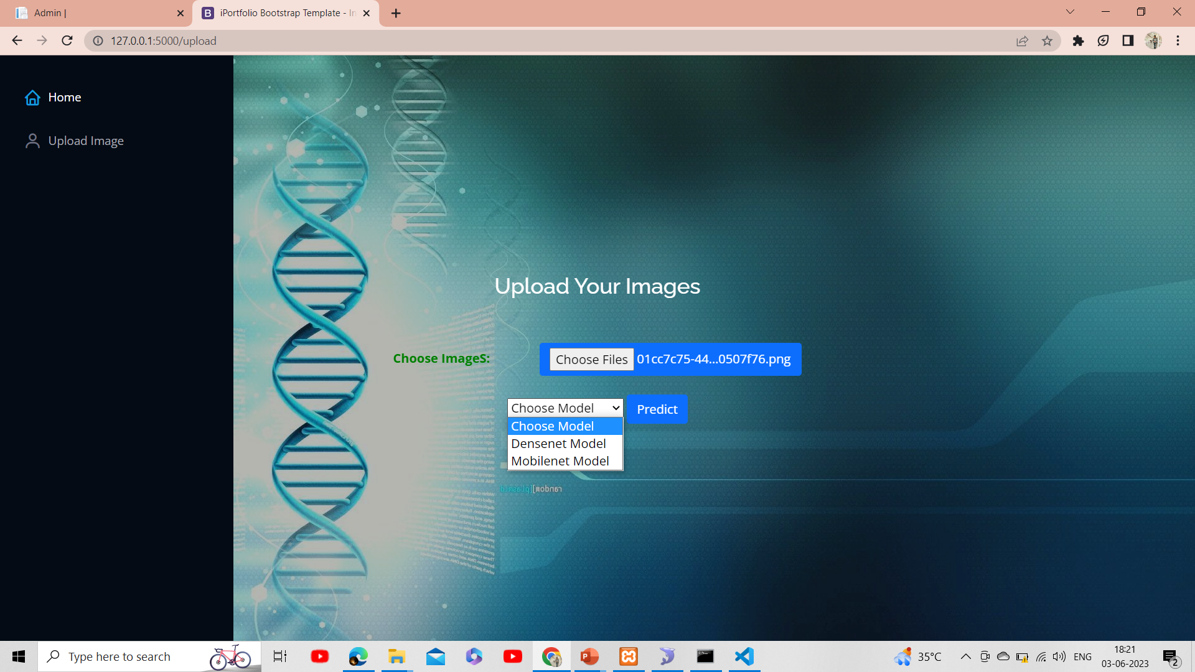

Slide 16
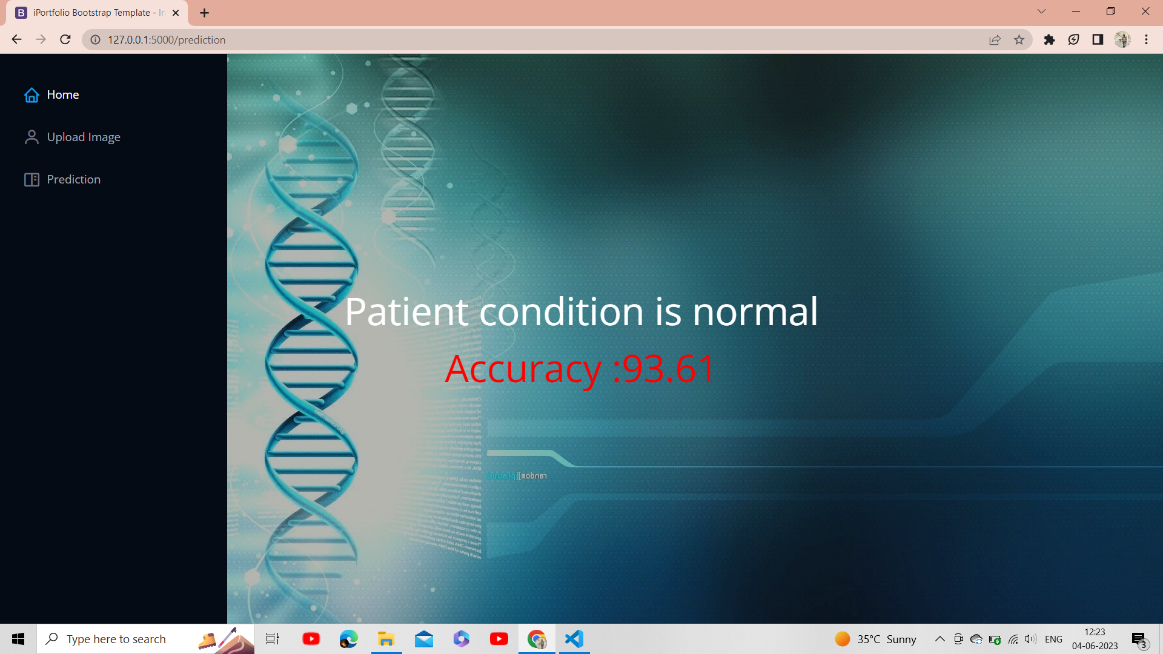

Slide 17
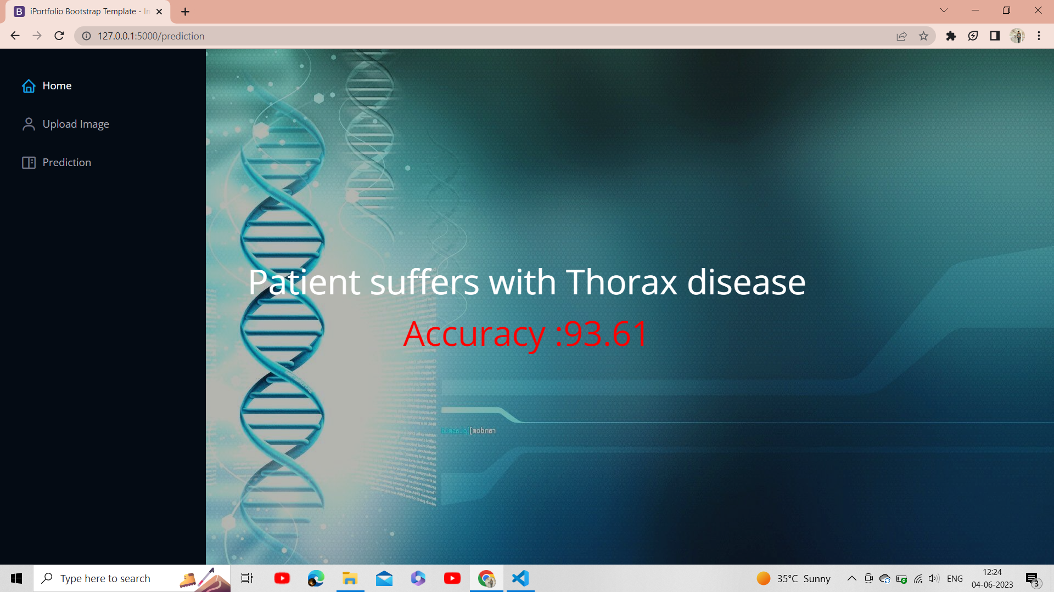

Slide 18
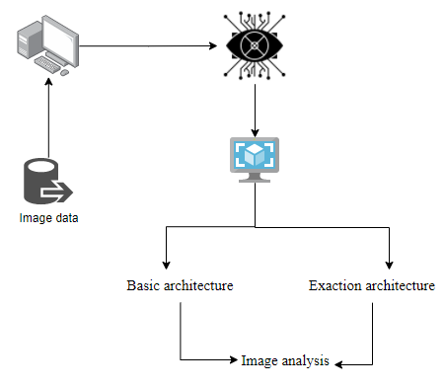
ARCHIECTURE

Slide 19
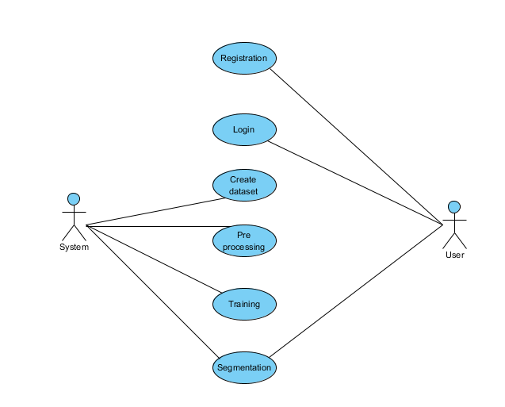
A use case diagram in the Unified Modeling Language (UML) is a type of behavioral diagram defined by and created from a Use-case analysis. Its purpose is to present a graphical overview of the functionality provided by a system in terms of actors, their goals (represented as use cases), and any dependencies between those use cases. The main purpose of a use case diagram is to show what system functions are performed for which actor. Roles of the actors in the system can be depicted.

Slide 20
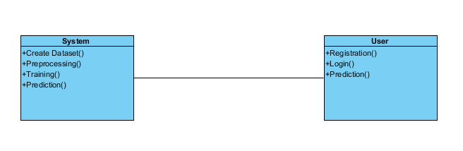
CLASS DIAGRAM
In software engineering, a class diagram in the Unified Modeling Language (UML) is a type of static structure diagram that describes the structure of a system by showing the system's classes, their attributes, operations (or methods), and the relationships among the classes. It explains which class contains information.

Slide 21
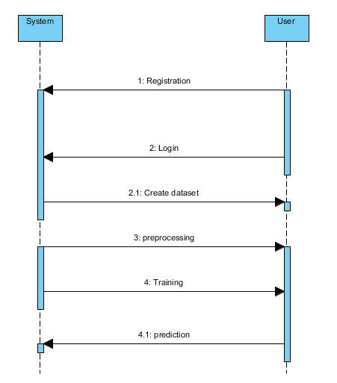
SEQUENCE DIAGRAM
A sequence diagram in Unified Modeling Language (UML) is a kind of interaction diagram that shows how processes operate with one another and in what order. It is a construct of a Message Sequence Chart. Sequence diagrams are sometimes called event diagrams, event scenarios, and timing diagrams

Slide 22
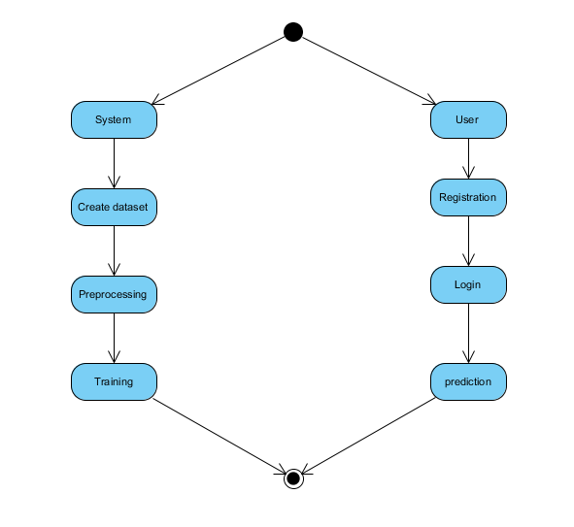
ACTIVITY DIAGRAM

Slide 23
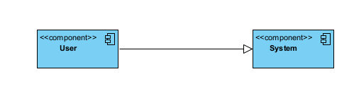
THE COMPONENT DIAGRAM

Slide 24
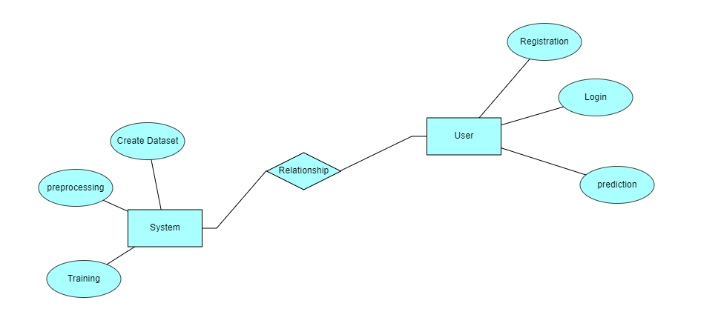
which is known as Entity Relationship Diagram (ER Diagram).
An ER diagram shows the relationship among entity sets. An entity set is a group of similar entities and these entities can have attributes.
In terms of DBMS, an entity is a table

Slide 25
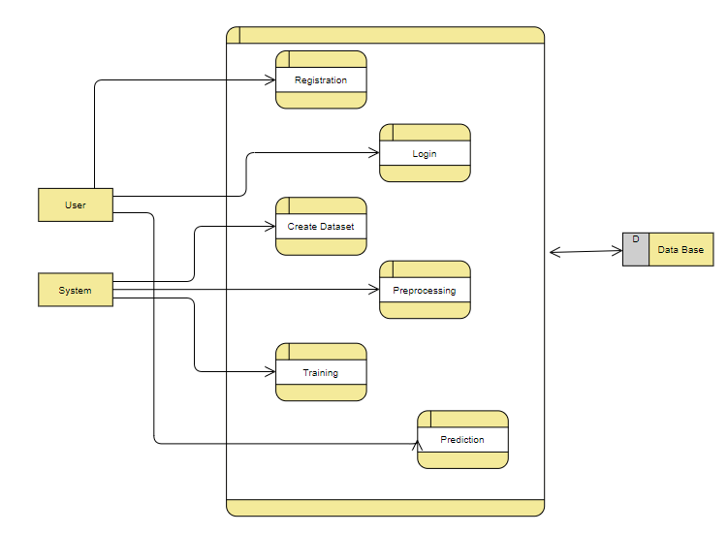
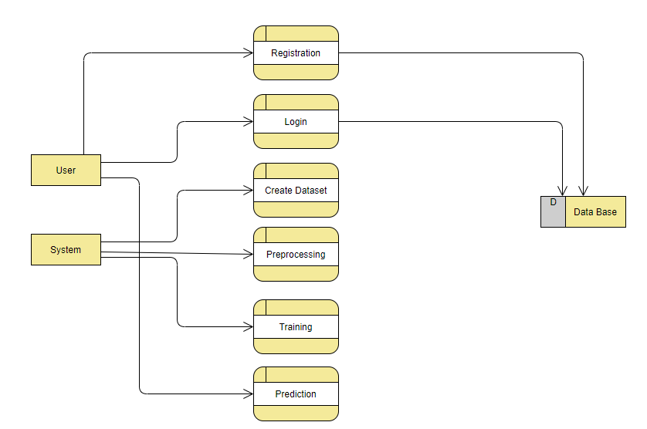
DF DIAGRAM
A Data Flow Diagram (DFD) is a traditional way to visualize the information flows within a system.
The purpose of a DFD is to show the scope and boundaries of a system as a whole
It shows how information enters and leaves the system, what changes the information and where information is stored.

Slide 26
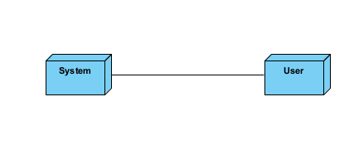
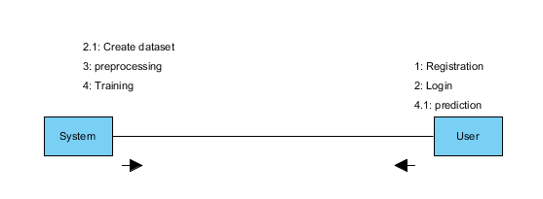
DEPLOYMENT DIAGRAM
COLLABORATION DIAGRAM

Slide 27
COMPARISON
Existing Method:
In existing system, a machine learning algorithm was used to detect the Thorax disease by using text or categorical data. As the input data in text or categorical it is inefficient to predict the disease and it does not give accurate classification results
Disadvantages:
More Computation time.
Time consuming.
Difficult to handle.
Less accurate.

Slide 28
ADVANTAGES
High accuracy.
Time Saving.
Computationally inexpensive.
Low complexities

Slide 29
MODULES
1. User:
1.1 Registration:
If the user is new to the application. He/ She needs to enter the valid details to register with the website
1.2 Login:
User should provide valid credentials to login into the application
1.3 Prediction:
User needs to upload the image to see whether the patient is having thorax disease or not.

Slide 30
2. System
2.1 Create Dataset:
The dataset containing images of the Retinal Lesion segmentation images with the identified vessel veins to be classified is split into training and testing dataset with the test size of 20-10%.
2.2 Pre-processing:
Resizing and reshaping the images into appropriate format to train our model.
2.3 Training:
Use the pre-processed training dataset is used to train our model using Encoder and Decoder architecture.
2.4 Prediction:
The results of our model are displayed on the front end.

Slide 31
ALGORITHMS
Dense Net:
In a traditional feed-forward Convolutional Neural Network (CNN), each convolutional layer except the first one (which takes in the input), receives the output of the previous convolutional layer and produces an output feature map that is then passed on to the next convolutional layer.
Therefore, for 'L' layers, there are 'L' direct connections; one between each layer and the next layer
However, as the number of layers in the CNN increase, i.e. as they get deeper, the 'vanishing gradient' problem arises. This means that as the path for information from the input to the output layers increases, it can cause certain information to 'vanish' or get lost which reduces the ability of the network to train effectively.

Slide 32
HARDWARE AND SOFTWARE REQUIREMENTS
H/W Configuration:
Processor - I3/Intel Processor
Hard Disk - 160GB
RAM - 8Gb
S/W Configuration:
Operating System : Windows 7/8/10
Server side Script : HTML, CSS & JS
IDE : Pycharm
Libraries Used :TensorFlow, OS, Scikit-Learn, Pandas.
Technology : Python 3.6+

Slide 33
CONCLUSION
We have successfully developed a system to predict whether the patient is having thorax disease or not in this application. This is created in a user-friendly environment with Python programming and Flask. The system is likely to gather images from the user in order to predict whether there is patient is having thorax disease or not.
FUTURE SCOPE
We intend to investigate prediction approach with the revised data set and employ the most accurate and relevant Architectures for the prediction of thorax disease.

Slide 34
REFERENCES
[1] Z. Tang, X. Liu, Y. Li, P.-T. Yap, and D. Shen, “Multi-atlas brain parcellation using squeeze-and-excitation fully convolutional networks,” IEEE Trans. Image Process., vol. 29, pp. 6864–6872, 2020.
[2] S. Zhou, D. Nie, E. Adeli, J. Yin, J. Lian and D. Shen, "High-Resolution Encoder–Decoder Networks for Low-Contrast Medical Image Segmentation," in IEEE Transactions on Image Processing, vol. 29, pp. 461-475, 2020, doi: 10.1109/TIP.2019.2919937.
[3]. Wisaeng, Kittipol & Sa-Ngiamvibool, Worawat. (2018). Automatic Detection of Exudates in Retinal Images using Region-Based, Neighborhood and Block Operation. Journal of Computer Science. 14. 438-452. 10.3844/jcssp.2018.438.452.
[4]. Z. Ji et al., "Deep Ranking for Image Zero-Shot Multi-Label Classification," in IEEE Transactions on Image Processing, vol. 29, pp. 6549-6560, 2020, doi: 10.1109/TIP.2020.2991527.
[5] Z. Li et al., "Thoracic Disease Identification and Localization with Limited Supervision," 2018 IEEE/CVF Conference on Computer Vision and Pattern Recognition, 2018, pp. 8290-8299, doi: 10.1109/CVPR.2018.00865.
[6]. D. -P. Fan et al., "Inf-Net: Automatic COVID-19 Lung Infection Segmentation From CT Images," in IEEE Transactions on Medical Imaging, vol. 39, no. 8, pp. 2626-2637, Aug. 2020, doi: 10.1109/TMI.2020.2996645.

Slide 35


